Slide 1

Picture Quality in AI

Slide 2
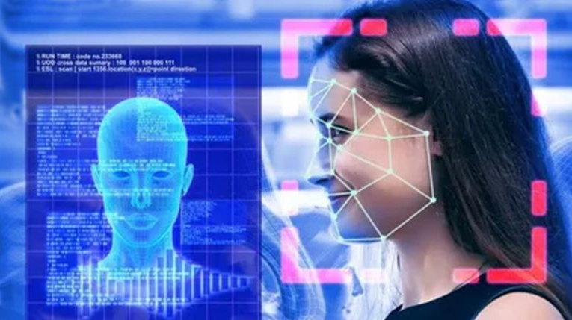
AI in Image Processing: Automates tasks via CNNs and GANs, improving image quality.
Applications: Crucial in medicine, security, autonomous vehicles, and entertainment.

Slide 3
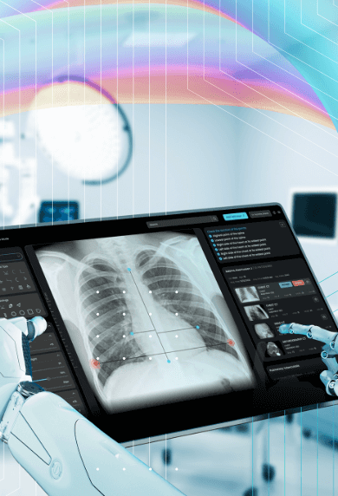
Importance of Image Quality in AI Applications
Medical Diagnostics: High-quality images aid precise detection and early diagnosis in medical imaging.
Security and Surveillance: Ensure accurate facial recognition and threat detection with clear images.
Autonomous Vehicles: Depend on high-resolution images for safe navigation and situational awareness.
Augmented/Virtual Reality: Enhance realism and engagement through detailed visual experiences.

Slide 4

Factors Affecting Image Quality in AI
Resolution and Detail: Higher resolution aids accurate analysis; detailed images enhance object recognition.
Noise and Artifacts: Noise obscures details; artifacts degrade AI performance.
Lighting and Exposure: Proper lighting ensures clarity; balanced exposure improves interpretation.
Color Accuracy and Compression: Accurate colors are vital; choose formats wisely to maintain quality.

Slide 5
Techniques for Improving Image Quality in AI
Image Denoising: CNNs reduce noise; Autoencoders reconstruct clean images.
1
Super-Resolution: GANs enhance resolution; SRGAN preserves fine details.
2
Image Inpainting: GANs fill missing parts; Partial Convolutional Networks focus on pixels.
3
Image Enhancement: Histogram Equalization adjusts contrast; Retinex Algorithms enhance visibility.
4

Slide 6
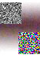
Challenges in Achieving High-Quality Images in AI
Data Quality and Quantity: Scarce high-quality data; labeling errors impact performance.
Computational Complexity: High-resource demands; slow processing affects real-time applications.
Noise and Artifacts: Pixel noise obscures details; compression degrades quality.
Imaging Conditions: Lighting variations; environmental factors impact clarity.

Slide 7
The Future of Image Quality in AI
Advancements in AI Algorithms: Sophisticated networks enhance image processing capabilities.
1
Integration of Multimodal Data: Combine modalities for comprehensive image enhancement.
2
Edge Computing and Real-Time Processing: Efficient algorithms enable real-time enhancements.
3
Ethical AI Development: Mitigate biases; ensure transparency and trust.
4

Slide 8
REFRENCES:
Woernle, A., Englman, C., Dickinson, L., Kirkham, A., Punwani, S., Haider, A., ... & Giganti, F. (2024). Picture perfect: the status of image quality in prostate MRI. Journal of Magnetic Resonance Imaging, 59(6), 1930-195‏
Kim, J., Zeng, H., Ghadiyaram, D., Lee, S., Zhang, L., & Bovik, A. C. (2017). Deep convolutional neural models for picture-quality prediction: Challenges and solutions to data-driven image quality assessment. IEEE Signal processing magazine, 34(6), 130-14‏
Lukas, F., & Budrikis, Z. (1982). Picture quality prediction based on a visual model. IEEE Transactions on Communications, 30(7), 1679-169‏V
Ai, Y. H., Ye, W., Feng, S. L., Hu, B., & Xie, M. (2006, September). Predictive picture refresh based on scene-context reference picture for video transmission. In 2006 International Conference on Wireless Communications, Networking and Mobile Computing (pp. 1-4). IEEE.‏

Slide 9


